Slide 1

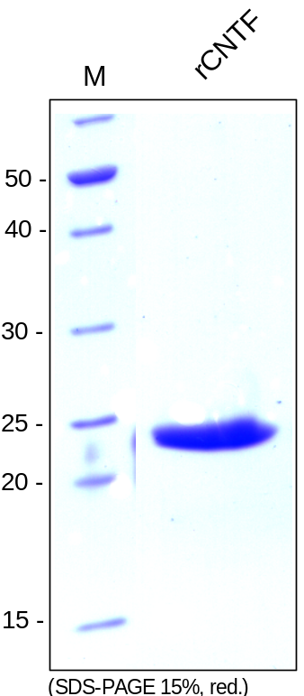
ReliaTech GmbH
Recombinant rat CTNF
(Cat #R20-001S / R20-001)
Figure 1: SDS-PAGE analysis of recombinant rat CNTF produced in E. coli. Sample was loaded under non-reducing conditions in 15% SDS-polyacrylamide gel and stained with Coomassie blue.
http://www.reliatech.de / orders@reliatech.de

